Slide 1
CS 412 Intro. to Data Mining
Chapter 7 : Advanced Frequent Pattern Mining
Jiawei Han, Computer Science, Univ. Illinois at Urbana-Champaign, 2106

Slide 2
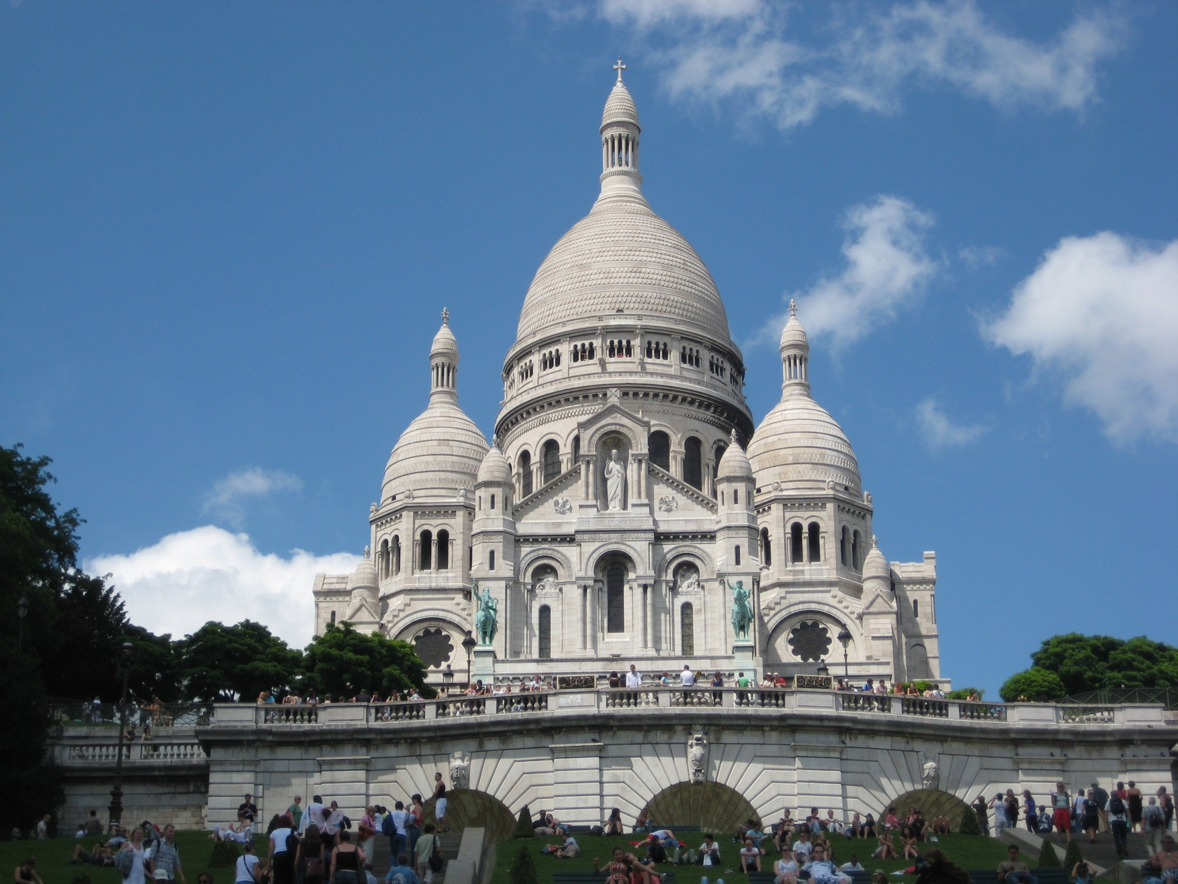
Notes:
Sacre Coeur in Montmartre

Slide 3
Chapter 7 : Advanced Frequent Pattern Mining
Pattern Mining: A Road Map
Mining Diverse Patterns
Constraint-Based Frequent Pattern Mining
Mining High-Dimensional Data and Colossal Patterns
Sequential Pattern Mining
Graph Pattern Mining
Summary

Slide 4
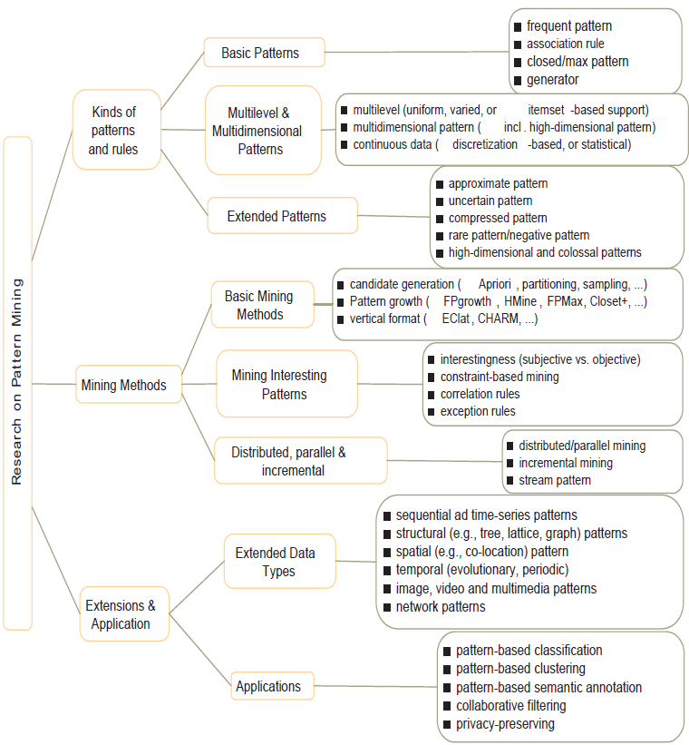
Research on Pattern Mining: A Road Map

Slide 5
Chapter 7 : Advanced Frequent Pattern Mining
Pattern Mining: A Road Map
Mining Diverse Patterns
Constraint-Based Frequent Pattern Mining
Mining High-Dimensional Data and Colossal Patterns
Sequential Pattern Mining
Graph Pattern Mining
Summary

Slide 6
Mining Diverse Patterns
Mining Multiple-Level Associations
Mining Multi-Dimensional Associations
Mining Quantitative Associations
Mining Negative Correlations
Mining Compressed and Redundancy-Aware Patterns

Slide 7
Mining Multiple-Level Frequent Patterns
Items often form hierarchies
Ex.: Dairyland 2% milk; Wonder wheat bread
How to set min-support thresholds?
Uniform support
Reduced support
Level 1
min_sup = 5%
Milk
[support = 10%]
Level 1
min_sup = 5%
Level 2
min_sup = 5%
2% Milk
[support = 6%]
Skim Milk
[support = 2%]
Level 2
min_sup = 1%
Uniform min-support across multiple levels (reasonable?)
Level-reduced min-support: Items at the lower level are expected to have lower support
Efficient mining: Shared multi-level mining
Use the lowest min-support to pass down the set of candidates

Slide 8
Redundancy Filtering at Mining Multi-Level Associations
Multi-level association mining may generate many redundant rules
Redundancy filtering: Some rules may be redundant due to “ancestor” relationships between items
(Suppose the 2% milk sold is about ¼ of milk sold in gallons)
milk ⇒ wheat bread [support = 8%, confidence = 70%] (1)
2% milk ⇒ wheat bread [support = 2%, confidence = 72%] (2)
A rule is redundant if its support is close to the “expected” value, according to its “ancestor” rule, and it has a similar confidence as its “ancestor”
Rule (1) is an ancestor of rule (2), which one to prune?

Slide 9
Customized Min-Supports for Different Kinds of Items
We have used the same min-support threshold for all the items or item sets to be mined in each association mining
In reality, some items (e.g., diamond, watch, …) are valuable but less frequent
It is necessary to have customized min-support settings for different kinds of items
One Method: Use group-based “individualized” min-support
E.g., {diamond, watch}: 0.05%; {bread, milk}: 5%; …
How to mine such rules efficiently?
Existing scalable mining algorithms can be easily extended to cover such cases

Slide 10
Mining Multi-Dimensional Associations
Single-dimensional rules (e.g., items are all in “product” dimension)
buys(X, “milk”) ⇒ buys(X, “bread”)
Multi-dimensional rules (i.e., items in ≥ 2 dimensions or predicates)
Inter-dimension association rules (no repeated predicates)
age(X, “18-25”) ∧ occupation(X, “student”) ⇒ buys(X, “coke”)
Hybrid-dimension association rules (repeated predicates)
age(X, “18-25”) ∧ buys(X, “popcorn”) ⇒ buys(X, “coke”)
Attributes can be categorical or numerical
Categorical Attributes (e.g., profession, product: no ordering among values): Data cube for inter-dimension association
Quantitative Attributes: Numeric, implicit ordering among values—discretization, clustering, and gradient approaches

Slide 11
Mining Quantitative Associations
Mining associations with numerical attributes
Ex.: Numerical attributes: age and salary
Methods
Static discretization based on predefined concept hierarchies
Data cube-based aggregation
Dynamic discretization based on data distribution
Clustering: Distance-based association
First one-dimensional clustering, then association
Deviation analysis:
Gender = female ⇒ Wage: mean=$7/hr (overall mean = $9)
()
(age)
(income)
(buys)
(age, income)
(age,buys)
(income, buys)
(age, income, buys)

Slide 12
Mining Extraordinary Phenomena in Quantitative Association Mining
Mining extraordinary (i.e., interesting) phenomena
Ex.: Gender = female ⇒ Wage: mean=$7/hr (overall mean = $9)
LHS: a subset of the population
RHS: an extraordinary behavior of this subset
The rule is accepted only if a statistical test (e.g., Z-test) confirms the inference with high confidence
Subrule: Highlights the extraordinary behavior of a subset of the population of the super rule
Ex.: (Gender = female) ^ (South = yes) ⇒ mean wage = $6.3/hr
Rule condition can be categorical or numerical (quantitative rules)
Ex.: Education in [14-18] (yrs) ⇒ mean wage = $11.64/hr
Efficient methods have been developed for mining such extraordinary rules (e.g., Aumann and Lindell@KDD’99)

Slide 13
Rare Patterns vs. Negative Patterns
Rare patterns
Very low support but interesting (e.g., buying Rolex watches)
How to mine them? Setting individualized, group-based min-support thresholds for different groups of items
Negative patterns
Negatively correlated: Unlikely to happen together
Ex.: Since it is unlikely that the same customer buys both a Ford Expedition (an SUV car) and a Ford Fusion (a hybrid car), buying a Ford Expedition and buying a Ford Fusion are likely negatively correlated patterns
How to define negative patterns?

Slide 14
Defining Negative Correlated Patterns
A support-based definition
If itemsets A and B are both frequent but rarely occur together, i.e., sup(A U B) << sup (A) × sup(B)
Then A and B are negatively correlated
Is this a good definition for large transaction datasets?
Ex.: Suppose a store sold two needle packages A and B 100 times each, but only one transaction contained both A and B
When there are in total 200 transactions, we have
s(A U B) = 0.005, s(A) × s(B) = 0.25, s(A U B) << s(A) × s(B)
But when there are 10⁵ transactions, we have
s(A U B) = 1/10⁵, s(A) × s(B) = 1/10³ × 1/10³, s(A U B) > s(A) × s(B)
What is the problem?—Null transactions: The support-based definition is not null-invariant!
Does this remind you the definition of lift?

Slide 15
Defining Negative Correlation: Need Null-Invariance in Definition
A good definition on negative correlation should take care of the null-invariance problem
Whether two itemsets A and B are negatively correlated should not be influenced by the number of null-transactions
A Kulczynski measure-based definition
If itemsets A and B are frequent but (P(A|B) + P(B|A))/2 < є, where є is a negative pattern threshold, then A and B are negatively correlated
For the same needle package problem:
No matter there are in total 200 or 10⁵ transactions
If є = 0.01, we have (P(A|B) + P(B|A))/2 = (0.01 + 0.01)/2 < є

Slide 16
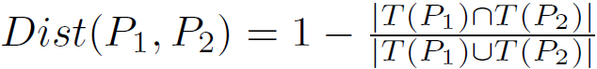
Mining Compressed Patterns
Pat-ID | Item-Sets | Support
P1 | {38,16,18,12} | 205227
P2 | {38,16,18,12,17} | 205211
P3 | {39,38,16,18,12,17} | 101758
P4 | {39,16,18,12,17} | 161563
P5 | {39,16,18,12} | 161576
Why mining compressed patterns?
Too many scattered patterns but not so meaningful
Pattern distance measure
δ-clustering: For each pattern P, find all patterns which can be expressed by P and whose distance to P is within δ (δ-cover)
All patterns in the cluster can be represented by P
Method for efficient, direct mining of compressed frequent patterns (e.g., D. Xin, J. Han, X. Yan, H. Cheng, "On Compressing Frequent Patterns", Knowledge and Data Engineering, 60:5-29, 2007)
Closed patterns
P1, P2, P3, P4, P5
Emphasizes too much on support
There is no compression
Max-patterns
P3: information loss
Desired output (a good balance):
P2, P3, P4

Slide 17
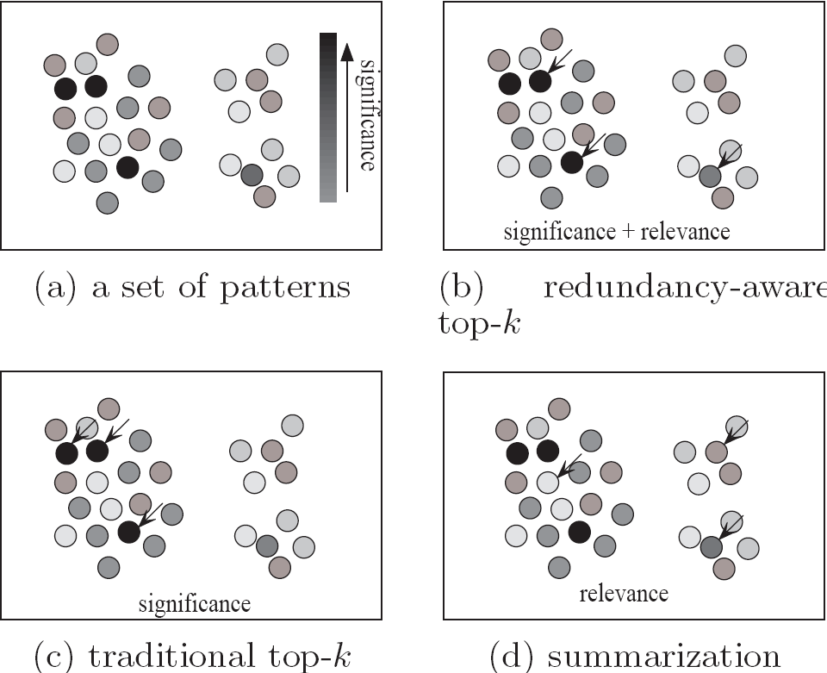
Redundancy-Aware Top-k Patterns
Desired patterns: high significance & low redundancy
Method: Use MMS (Maximal Marginal Significance) for measuring the combined significance of a pattern set
Xin et al., Extracting Redundancy-Aware Top-K Patterns, KDD’06

Slide 18
Chapter 7 : Advanced Frequent Pattern Mining
Pattern Mining: A Road Map
Mining Diverse Patterns
Constraint-Based Frequent Pattern Mining
Mining High-Dimensional Data and Colossal Patterns
Sequential Pattern Mining
Graph Pattern Mining
Summary

Slide 19
Why Constraint-Based Mining?
Finding all the patterns in a dataset autonomously? — unrealistic!
Too many patterns but not necessarily user-interested!
Pattern mining should be an interactive process
User directs what to be mined using a data mining query language (or a graphical user interface)
Constraint-based mining
User flexibility: provides constraints on what to be mined
Optimization: explores such constraints for efficient mining
Constraint-based mining: Constraint-pushing, similar to push selection first in DB query processing

Slide 20
Constraints in General Data Mining
A data mining query can be in the form of a meta-rule or with the following language primitives
Knowledge type constraint:
Ex.: classification, association, clustering, outlier finding, ....
Data constraint — using SQL-like queries
Ex.: find products sold together in NY stores this year
Dimension/level constraint
Ex.: in relevance to region, price, brand, customer category
Rule (or pattern) constraint
Ex.: small sales (price < $10) triggers big sales (sum > $200)
Interestingness constraint
Ex.: strong rules: min_sup ≥ 0.02, min_conf ≥ 0.6, min_correlation ≥ 0.7

Slide 21
Meta-Rule Guided Mining
A meta-rule can contain partially instantiated predicates & constants
P₁(X, Y) ^ P₂(X, W) ⇒ buys(X, “iPad”)
The resulting mined rule can be
age(X, “15-25”) ^ profession(X, “student”) ⇒ buys(X, “iPad”)
In general, (meta) rules can be in the form of
P₁ ^ P₂ ^ … ^ P_{l} ⇒ Q₁ ^ Q₂ ^ … ^ Q_{r}
Method to find meta-rules
Find frequent (l + r) predicates (based on min-support)
Push constants deeply when possible into the mining process
Using constraint-push techniques introduced in this lecture
Also, push min_conf, min_correlation, and other measures as early as possible (measures acting as constraints)

Slide 22
Different Kinds of Constraints Lead to Different Pruning Strategies
Constraints can be categorized as
Pattern space pruning constraints vs. data space pruning constraints
Pattern space pruning constraints
Anti-monotonic: If constraint c is violated, its further mining can be terminated
Monotonic: If c is satisfied, no need to check c again
Succinct: if the constraint c can be enforced by directly manipulating the data
Convertible: c can be converted to monotonic or anti-monotonic if items can be properly ordered in processing
Data space pruning constraints
Data succinct: Data space can be pruned at the initial pattern mining process
Data anti-monotonic: If a transaction t does not satisfy c, then t can be pruned to reduce data processing effort

Slide 23
Pattern Space Pruning with Pattern Anti-Monotonicity
Constraint c is anti-monotone
If an itemset S violates constraint c, so does any of its superset
That is, mining on itemset S can be terminated
Ex. 1: c₁: sum(S.price) ≤ v is anti-monotone
Ex. 2: c₂: range(S.profit) ≤ 15 is anti-monotone
Itemset ab violates c₂ (range(ab) = 40)
So does every superset of ab
Ex. 3. c₃: sum(S.Price) ≥ v is not anti-monotone
Ex. 4. Is c₄: support(S) ≥ σ anti-monotone?
Yes! Apriori pruning is essentially pruning with an anti-monotonic constraint!
TID | Transaction
10 | a, b, c, d, f, h
20 | b, c, d, f, g, h
30 | b, c, d, f, g
40 | a, c, e, f, g
Item | Profit
a | 40
b | 0
c | -20
d | -15
e | -30
f | -10
g | 20
h | 5
min_sup = 2
price(item)>0

Slide 24
Pattern Monotonicity and Its Roles
TID | Transaction
10 | a, b, c, d, f, h
20 | b, c, d, f, g, h
30 | b, c, d, f, g
40 | a, c, e, f, g
Item | Profit
a | 40
b | 0
c | -20
d | -15
e | -30
f | -10
g | 20
h | 5
A constraint c is monotone: if an itemset S satisfies the constraint c, so does any of its superset
That is, we do not need to check c in subsequent mining
Ex. 1: c₁: sum(S.Price) ≥ v is monotone
Ex. 2: c₂: min(S.Price) ≤ v is monotone
Ex. 3: c₃: range(S.profit) ≥ 15 is monotone
Itemset ab satisfies c₃
So does every superset of ab
min_sup = 2
price(item)>0

Slide 25
Data Space Pruning with Data Anti-Monotonicity
A constraint c is data anti-monotone: In the mining process, if a data entry t cannot satisfy a pattern p under c, t cannot satisfy p’s superset either
Data space pruning: Data entry t can be pruned
Ex. 1: c₁: sum(S.Profit) ≥ v is data anti-monotone
Let constraint c₁ be: sum{S.Profit} ≥ 25
T₃₀: {b, c, d, f, g} can be removed since none of their combinations can make an S whose sum of the profit is ≥ 25
Ex. 2: c₂: min(S.Price) ≤ v is data anti-monotone
Consider v = 5 but every item in transaction T₅₀ has a price higher than 10
Ex. 3: c₃: range(S.Profit) ≥ 25 is data anti-monotone
TID | Transaction
10 | a, b, c, d, f, h
20 | b, c, d, f, g, h
30 | b, c, d, f, g
40 | a, c, e, f, g
Item | Profit
a | 40
b | 0
c | -20
d | -15
e | -30
f | -10
g | 20
h | 5
min_sup = 2
price(item)>0

Slide 26
Data Space Pruning Should Be Explored Recursively
b’s-proj. DB
Example. c₃: range(S.Profit) > 25
We check b’s projected database
But item “a” is infrequent (sup = 1)
After removing “a (40)” from T₁₀
T₁₀ cannot satisfy c₃ any more
since “b (0)” and “c (-20), d (-15), f (-10), h (5)”
By removing T₁₀, we can also prune “h” in T₂₀
TID | Transaction
10 | a, c, d, f, h
20 | c, d, f, g, h
30 | c, d, f, g
TID | Transaction
10 | a, b, c, d, f, h
20 | b, c, d, f, g, h
30 | b, c, d, f, g
40 | a, c, e, f, g
Item | Profit
a | 40
b | 0
c | -20
d | -15
e | -30
f | -10
g | 20
h | 5
min_sup = 2
price(item)>0
Constraint:
range{S.profit} ≥ 25
b’s-proj. DB
TID | Transaction
10 | a, c, d, f, h
20 | c, d, f, g, h
30 | c, d, f, g
Recursive
Data
Pruning
b’s FP-tree
single branch: cdfg: 2
Only a single branch “cdfg: 2” to be mined in b’s projected DB
Note: c₃ prunes T₁₀ effectively only after “a” is pruned (by min-sup) in b’s projected DB

Slide 27
Succinctness: Pruning Both Data and Pattern Spaces
Succinctness: if the constraint c can be enforced by directly manipulating the data
Ex. 1: To find those patterns without item i
Remove i from DB and then mine (pattern space pruning)
Ex. 2: To find those patterns containing item i
Mine only i-projected DB (data space pruning)
Ex. 3: c₃: min(S.Price) ≤ v is succinct
Start with only items whose price ≤ v (pattern space pruning) and remove transactions with high-price items only (data space pruning)
Ex. 4: c₄: sum(S.Price) ≥ v is not succinct
It cannot be determined beforehand since sum of the price of itemset S keeps increasing

Slide 28
Convertible Constraints: Ordering Data in Transactions
Convert tough constraints into (anti-)monotone by proper ordering of items in transactions
Examine c₁: avg(S.profit) > 20
Order items in value-descending order
<a, g, f, h, b, d, c, e>
An itemset ab violates c₁ (avg(ab) = 20)
So does ab* (i.e., ab-projected DB)
C₁: anti-monotone if patterns grow in the right order!
Can item-reordering work for Apriori?
Does not work for level-wise candidate generation!
avg(agf) = 23.3 > 20, but avg(gf) = 15 < 20
Item | Profit
a | 40
b | 0
c | -20
d | -15
e | -30
f | 10
g | 20
h | 5
min_sup = 2
price(item)>0
TID | Transaction
10 | a, b, c, d, f, h
20 | b, c, d, f, g, h
30 | b, c, d, f, g
40 | a, c, e, f, g

Slide 29
How to Handle Multiple Constraints?
It is beneficial to use multiple constraints in pattern mining
But different constraints may require potentially conflicting item-ordering
If there exists an order R making both c₁ and c₂ convertible, try to sort items in the order that benefits pruning most
If there exists conflict ordering between c₁ and c₂
Try to sort data and enforce one constraint first (which one?)
Then enforce the other when mining the projected databases
Ex. c₁: avg(S.profit) > 20, and c₂: avg(S.price) < 50
Sorted in profit descending order and use c₁ first (assuming c₁ has more pruning power)
For each project DB, sort trans. in price ascending order and use c₂ at mining

Slide 30
Chapter 7 : Advanced Frequent Pattern Mining
Pattern Mining: A Road Map
Mining Diverse Patterns
Constraint-Based Frequent Pattern Mining
Mining High-Dimensional Data and Colossal Patterns
Sequential Pattern Mining
Graph Pattern Mining
Summary

Slide 31
Mining Long Patterns: Challenges
Mining long patterns is needed in bioinformatics, social network analysis, software engineering, …
But the methods introduced so far mine only short patterns (e.g., length < 10)
Challenges of mining long patterns
The curse of “downward closure” property of frequent patterns
Any sub-pattern of a frequent pattern is frequent
If {a₁, a₂, …, a₁₀₀} is frequent, then {a₁}, {a₂}, …, {a₁₀₀}, {a₁, a₂}, {a₁, a₃}, …, {a₁, a₁₀₀}, {a₁, a₂, a₃}, … are all frequent! There are about 2¹⁰⁰ such frequent itemsets!
No matter searching in breadth-first (e.g., Apriori) or depth-first (e.g., FPgrowth), if we still adopt the “small to large” step-by-step growing paradigm, we have to examine so many patterns, which leads to combinatorial explosion!

Slide 32
Colossal Patterns: A Motivating Example
T1 = 2 3 4 ….. 39 40
T2 = 1 3 4 ….. 39 40
: .
: .
: .
: .
T40=1 2 3 4 …… 39
Let min-support σ= 20
# of closed/maximal patterns of size 20: about
But there is only one pattern with size close to 40 (i.e., long or colossal)
α= {41,42,…,79} of size 39
Q: How to find it without generating an exponential number of size-20 patterns?
T41= 41 42 43 ….. 79
T42= 41 42 43 ….. 79
: .
: .
T60= 41 42 43 … 79
The existing fastest mining algorithms (e.g., FPClose, LCM) fail to complete running
A new algorithm, Pattern-Fusion, outputs this colossal pattern in seconds

Slide 33
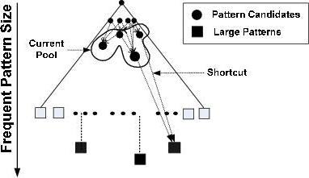
What Is Pattern-Fusion?
Not strive for completeness (why?)
Jump out of the swamp of the mid-sized intermediate “results”
Strive for mining almost complete and representative colossal patterns: identify “short-cuts” and take “leaps”
swamp of mid-sized patterns
small # of colossal patterns
Key observation
The larger the pattern or the more distinct the pattern, the greater chance it will be generated from small ones
Philosophy: Collection of small patterns hints at the larger patterns
Pattern fusion strategy (“not crawl but jump”): Fuse small patterns together in one step to generate new pattern candidates of significant sizes

Slide 34
Observation: Colossal Patterns and Core Patterns
Suppose dataset D contains 4 colossal patterns (below) plus many small patterns
{a₁, a₂, …, a₅₀}: 40, {a₃, a₆, …, a₉₉}: 60, {a₅, a₁₀, …, a₉₅}: 80, {a₁₀, a₂₀, …, a₁₀₀}: 100
If you check the pattern pool of size-3, you may likely find
{a₂, a₄, a₄₅}: ~40; {a₃, a₃₄, a₃₉}: ~40; …, {a₅, a₁₅, a₈₅}: ~80, …, {a₂₀, a₄₀, a₈₅}: ~80, …
If you merge the patterns with similar support, you may obtain candidates of much bigger size and easily validate whether they are true patterns
Core patterns of a colossal pattern α: A set of subpatterns of α that cluster around α by sharing a similar support
A colossal pattern has far more core patterns than a small-sized pattern
A random draw from a complete set of pattern of size c would be more likely to pick a core pattern (or its descendant) of a colossal pattern
A colossal pattern can be generated by merging a set of core patterns

Slide 35
Robustness of Colossal Patterns
Core Patterns: For a frequent pattern α, a subpattern β is a τ-core pattern of α if β shares a similar support set with α, i.e.,
(d, τ)-robustness: A pattern α is (d, τ)-robust if d is the maximum number of items that can be removed from α for the resulting pattern to remain a τ-core pattern of α
For a (d, τ)-robust pattern α, it has core patterns
Robustness of Colossal Patterns: A colossal pattern tends to have much more core patterns than small patterns
Such core patterns can be clustered together to form “dense balls” based on pattern distance defined by
where τ is called the core ratio
A random draw in the pattern space will hit somewhere in the ball with high probability

Slide 36
The Pattern-Fusion Algorithm
Initialization (Creating initial pool): Use an existing algorithm to mine all frequent patterns up to a small size, e.g., 3
Iteration (Iterative Pattern Fusion):
At each iteration, K seed patterns are randomly picked from the current pattern pool
For each seed pattern thus picked, we find all the patterns within a bounding ball centered at the seed pattern
All these patterns found are fused together to generate a set of super-patterns
All the super-patterns thus generated form a new pool for the next iteration
Termination: when the current pool contains no more than K patterns at the beginning of an iteration

Slide 37
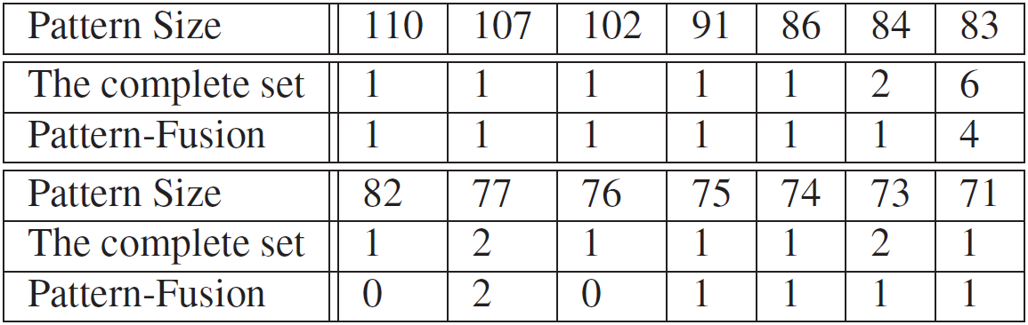
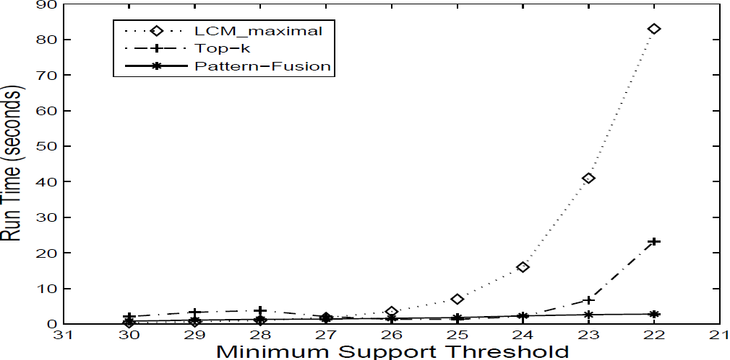
Experimental Results on Data Set: ALL
ALL: A popular gene expression clinical data set on ALL-AML leukemia, with 38 transactions, each with 866 columns. There are 1736 items in total.
When minimum support is high (e.g., 30), Pattern-Fusion gets all the largest colossal patterns with size greater than 85
Mining colossal patterns on a Leukemia dataset
Algorithm runtime comparison on another dataset

Slide 38
Chapter 7 : Advanced Frequent Pattern Mining
Pattern Mining: A Road Map
Mining Diverse Patterns
Constraint-Based Frequent Pattern Mining
Mining High-Dimensional Data and Colossal Patterns
Sequential Pattern Mining
Graph Pattern Mining
Summary

Slide 39
Sequence Databases & Sequential Patterns
Sequential pattern mining has broad applications
Customer shopping sequences
Purchase a laptop first, then a digital camera, and then a smartphone, within 6 months
Medical treatments, natural disasters (e.g., earthquakes), science & engineering processes, stocks and markets, ...
Weblog click streams, calling patterns, …
Software engineering: Program execution sequences, …
Biological sequences: DNA, protein, …
Transaction DB, sequence DB vs. time-series DB
Gapped vs. non-gapped sequential patterns
Shopping sequences, clicking streams vs. biological sequences

Slide 40
Sequential Pattern and Sequential Pattern Mining
Sequential pattern mining: Given a set of sequences, find the complete set of frequent subsequences (i.e., satisfying the min_sup threshold)
A sequence database
A sequence: < (ef) (ab) (df) c b >
SID | Sequence
10 | <a(abc)(ac)d(cf)>
20 | <(ad)c(bc)(ae)>
30 | <(ef)(ab)(df)cb>
40 | <eg(af)cbc>
An element may contain a set of items (also called events)
Items within an element are unordered and we list them alphabetically
<a(bc)dc> is a subsequence of <a(abc)(ac)d(cf)>
Given support threshold min_sup = 2, <(ab)c> is a sequential pattern

Slide 41
Sequential Pattern Mining Algorithms
Algorithm requirement: Efficient, scalable, finding complete set, incorporating various kinds of user-specific constraints
The Apriori property still holds: If a subsequence s₁ is infrequent, none of s₁’s super-sequences can be frequent
Representative algorithms
GSP (Generalized Sequential Patterns): Srikant & Agrawal @ EDBT’96)
Vertical format-based mining: SPADE (Zaki@Machine Leanining’00)
Pattern-growth methods: PrefixSpan (Pei, et al. @TKDE’04)
Mining closed sequential patterns: CloSpan (Yan, et al. @SDM’03)
Constraint-based sequential pattern mining

Slide 42
GSP: Apriori-Based Sequential Pattern Mining
Initial candidates: All singleton sequences
<a>, <b>, <c>, <d>, <e>, <f>, <g>, <h>
Scan DB once, count support for each candidate
Generate length-2 candidate sequences
SID | Sequence
10 | <(bd)cb(ac)>
20 | <(bf)(ce)b(fg)>
30 | <(ah)(bf)abf>
40 | <(be)(ce)d>
50 | <a(bd)bcb(ade)>
min_sup = 2
 | <a> | <b> | <c> | <d> | <e> | <f>
<a> | <aa> | <ab> | <ac> | <ad> | <ae> | <af>
<b> | <ba> | <bb> | <bc> | <bd> | <be> | <bf>
<c> | <ca> | <cb> | <cc> | <cd> | <ce> | <cf>
<d> | <da> | <db> | <dc> | <dd> | <de> | <df>
<e> | <ea> | <eb> | <ec> | <ed> | <ee> | <ef>
<f> | <fa> | <fb> | <fc> | <fd> | <fe> | <ff>
Cand. | sup
<a> | 3
<b> | 5
<c> | 4
<d> | 3
<e> | 3
<f> | 2
<g> | 1
<h> | 1
Length-2 candidates:
36 + 15= 51
Without Apriori pruning:
8*8+8*7/2=92 candidates
 | <a> | <b> | <c> | <d> | <e> | <f>
<a> |  | <(ab)> | <(ac)> | <(ad)> | <(ae)> | <(af)>
<b> |  |  | <(bc)> | <(bd)> | <(be)> | <(bf)>
<c> |  |  |  | <(cd)> | <(ce)> | <(cf)>
<d> |  |  |  |  | <(de)> | <(df)>
<e> |  |  |  |  |  | <(ef)>
<f>
GSP (Generalized Sequential Patterns): Srikant & Agrawal @ EDBT’96)

Slide 43
GSP Mining and Pruning
5th scan: 1 cand. 1 length-5 seq. pat.
<(bd)cba>
Candidates cannot pass min_sup threshold
4th scan: 8 cand. 7 length-4 seq. pat.
<abba> <(bd)bc> …
Candidates not in DB
3rd scan: 46 cand. 20 length-3 seq. pat. 20 cand. not in DB at all
<abb> <aab> <aba> <baa> <bab> …
2nd scan: 51 cand. 19 length-2 seq. pat. 10 cand. not in DB at all
<aa> <ab> … <af> <ba> <bb> … <ff> <(ab)> … <(ef)>
1st scan: 8 cand. 6 length-1 seq. pat.
<a> <b> <c> <d> <e> <f> <g> <h>
min_sup = 2
Repeat (for each level (i.e., length-k))
Scan DB to find length-k frequent sequences
Generate length-(k+1) candidate sequences from length-k frequent sequences using Apriori
set k = k+1
Until no frequent sequence or no candidate can be found
SID | Sequence
10 | <(bd)cb(ac)>
20 | <(bf)(ce)b(fg)>
30 | <(ah)(bf)abf>
40 | <(be)(ce)d>
50 | <a(bd)bcb(ade)>

Slide 44
Sequential Pattern Mining in Vertical Data Format: The SPADE Algorithm
A sequence database is mapped to: <SID, EID>
Grow the subsequences (patterns) one item at a time by Apriori candidate generation
SID | Sequence
1 | <a(abc)(ac)d(cf)>
2 | <(ad)c(bc)(ae)>
3 | <(ef)(ab)(df)cb>
4 | <eg(af)cbc>
min_sup = 2
Ref: SPADE (Sequential PAttern Discovery using Equivalent Class) [M. Zaki 2001]

Slide 45
PrefixSpan: A Pattern-Growth Approach
SID | Sequence
10 | <a(abc)(ac)d(cf)>
20 | <(ad)c(bc)(ae)>
30 | <(ef)(ab)(df)cb>
40 | <eg(af)cbc>
Prefix | Suffix (Projection)
<a> | <(abc)(ac)d(cf)>
<aa> | <(_bc)(ac)d(cf)>
<ab> | <(_c)(ac)d(cf)>
Prefix and suffix
Given <a(abc)(ac)d(cf)>
Prefixes: <a>, <aa>, <a(ab)>, <a(abc)>, …
Suffix: Prefixes-based projection
PrefixSpan Mining: Prefix Projections
Step 1: Find length-1 sequential patterns
<a>, <b>, <c>, <d>, <e>, <f>
Step 2: Divide search space and mine each projected DB
<a>-projected DB,
<b>-projected DB,
…
<f>-projected DB, …
PrefixSpan (Prefix-projected Sequential pattern mining) Pei, et al. @TKDE’04

Slide 46
PrefixSpan: Mining Prefix-Projected DBs
SID | Sequence
10 | <a(abc)(ac)d(cf)>
20 | <(ad)c(bc)(ae)>
30 | <(ef)(ab)(df)cb>
40 | <eg(af)cbc>
Length-1 sequential patterns
<a>, <b>, <c>, <d>, <e>, <f>
prefix <a>
prefix <b>
prefix <c>, …, <f>
<a>-projected DB
<(abc)(ac)d(cf)>
<(_d)c(bc)(ae)>
<(_b)(df)cb>
<(_f)cbc>
<b>-projected DB
…
Length-2 sequential
patterns
<aa>, <ab>, <(ab)>,
<ac>, <ad>, <af>
… …
prefix <aa>
prefix <af>
Major strength of PrefixSpan:
No candidate subseqs. to be generated
Projected DBs keep shrinking
<aa>-projected DB
…
<af>-projected DB

Slide 47
Implementation Consideration: Pseudo-Projection vs. Physical Projection
Major cost of PrefixSpan: Constructing projected DBs
Suffixes largely repeating in recursive projected DBs
When DB can be held in main memory, use pseudo projection
No physically copying suffixes
Pointer to the sequence
Offset of the suffix
But if it does not fit in memory
Physical projection
Suggested approach:
Integration of physical and pseudo-projection
Swapping to pseudo-projection when the data fits in memory
s = <a(abc)(ac)d(cf)>
<a>
s|<a>: ( , 2)
<(abc)(ac)d(cf)>
<ab>
s|<ab>: ( , 4)
<(_c)(ac)d(cf)>

Slide 48
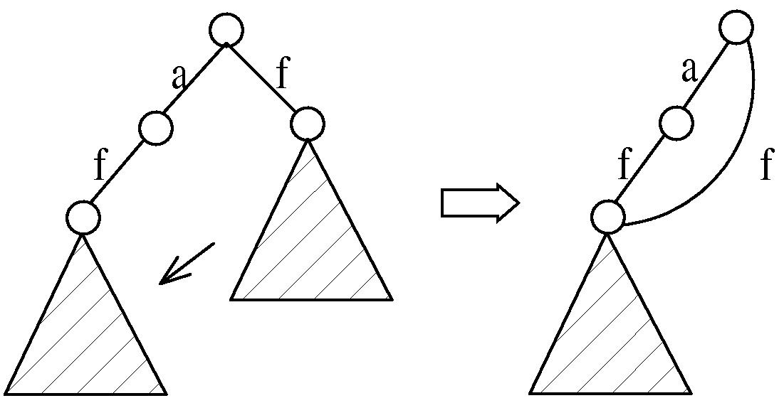
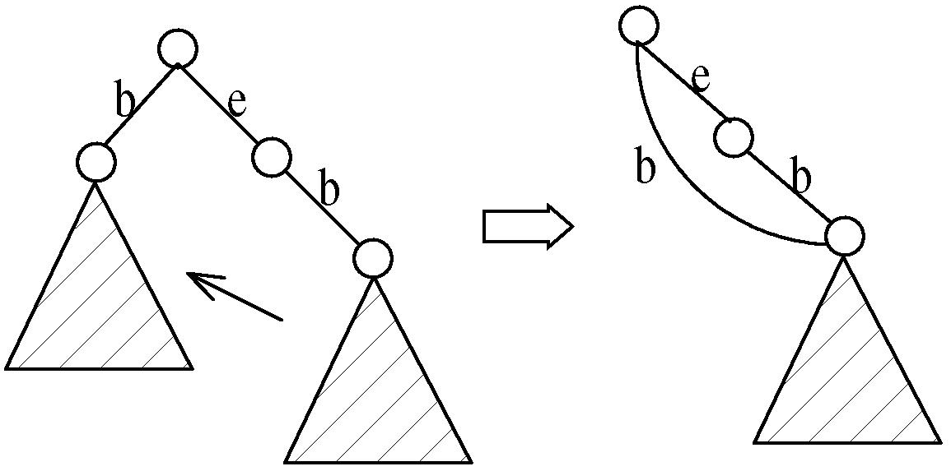
CloSpan: Mining Closed Sequential Patterns
A closed sequential pattern s: There exists no superpattern s’ such that s’ כ s, and s’ and s have the same support
Which ones are closed? <abc>: 20, <abcd>:20, <abcde>: 15
Why directly mine closed sequential patterns?
Reduce # of (redundant) patterns
Attain the same expressive power
Property P₁: If s כ s₁, s is closed iff two project DBs have the same size
Explore Backward Subpattern and Backward Superpattern pruning to prune redundant search space
Greatly enhances efficiency (Yan, et al., SDM’03)

Slide 49
Constraint-Based Sequential-Pattern Mining
Share many similarities with constraint-based itemset mining
Anti-monotonic: If S violates c, the super-sequences of S also violate c
sum(S.price) < 150; min(S.value) > 10
Monotonic: If S satisfies c, the super-sequences of S also do so
element_count (S) > 5; S ⊇ {PC, digital_camera}
Data anti-monotonic: If a sequence s₁ with respect to S violates c₃, s₁ can be removed
c₃: sum(S.price) ≥ v
Succinct: Enforce constraint c by explicitly manipulating data
S ⊇ {i-phone, MacAir}
Convertible: Projection based on the sorted value not sequence order
value_avg(S) < 25; profit_sum (S) > 160
max(S)/avg(S) < 2; median(S) – min(S) > 5

Slide 50
Timing-Based Constraints in Seq.-Pattern Mining
Order constraint: Some items must happen before the other
{algebra, geometry} → {calculus} (where “→” indicates ordering)
Anti-monotonic: Constraint-violating sub-patterns pruned
Min-gap/max-gap constraint: Confines two elements in a pattern
E.g., mingap = 1, maxgap = 4
Succinct: Enforced directly during pattern growth
Max-span constraint: Maximum allowed time difference between the 1st and the last elements in the pattern
E.g., maxspan (S) = 60 (days)
Succinct: Enforced directly when the 1st element is determined
Window size constraint: Events in an element do not have to occur at the same time: Enforce max allowed time difference
E.g., window-size = 2: Various ways to merge events into elements

Slide 51
Episodes and Episode Pattern Mining
Episodes and regular expressions: Alternative to seq. patterns
Serial episodes: A → B
Parallel episodes: A | B
Regular expressions: (A|B)C*(D → E)
Methods for episode pattern mining
Variations of Apriori/GSP-like algorithms
Projection-based pattern growth
Q₁: Can you work out the details?
Q₂: What are the differences between mining episodes and constraint-based pattern mining?
Indicating partial order relationships

Slide 52
Chapter 7 : Advanced Frequent Pattern Mining
Pattern Mining: A Road Map
Mining Diverse Patterns
Constraint-Based Frequent Pattern Mining
Mining High-Dimensional Data and Colossal Patterns
Sequential Pattern Mining
Graph Pattern Mining
Summary

Slide 53
Frequent (Sub)Graph Patterns
Given a labeled graph dataset D = {G₁, G₂, …, G_{n}), the supporting graph set of a subgraph g is D_{g} = {G_{i} | g ⊆ G_{i}, G_{i} ∈D}.
support(g) = |D_{g}|/ |D|
A (sub)graph g is frequent if support(g) ≥ min_sup
Ex.: Chemical structures
Graph Dataset
Alternative:
Mining frequent subgraph patterns from a single large graph or network
(A)
(B)
(C)
min_sup = 2
Frequent Graph Patterns
(1)
(2)
support = 67%

Slide 54
Applications of Graph Pattern Mining
Bioinformatics
Gene networks, protein interactions, metabolic pathways
Chem-informatics: Mining chemical compound structures
Social networks, web communities, tweets, …
Cell phone networks, computer networks, …
Web graphs, XML structures, semantic Web, information networks
Software engineering: program execution flow analysis
Building blocks for graph classification, clustering, compression, comparison, and correlation analysis
Graph indexing and graph similarity search

Slide 55
Graph Pattern Mining Algorithms: Different Methodologies
Generation of candidate subgraphs
Apriori vs. pattern growth (e.g., FSG vs. gSpan)
Search order
Breadth vs. depth
Elimination of duplicate subgraphs
Passive vs. active (e.g., gSpan (Yan&Han’02))
Support calculation
Store embeddings (e.g., GASTON (Nijssen&Kok’04, FFSM (Huan, et al.’03), MoFa (Borgelt and Berthold ICDM’02))
Order of pattern discovery
Path → tree → graph (e.g., GASTON (Nijssen&Kok’04)

Slide 56
Apriori-Based Approach
The Apriori property (anti-monotonicity): A size-k subgraph is frequent if and only if all of its subgraphs are frequent
A candidate size-(k+1) edge/vertex subgraph is generated if its corresponding two k-edge/vertex subgraphs are frequent
Iterative mining process:
Candidate-generation → candidate pruning → support counting → candidate elimination
(k+1)-edge
k-edge
G₁
G
G₂
G’
…
G’’
G_{n}
Join

Slide 57
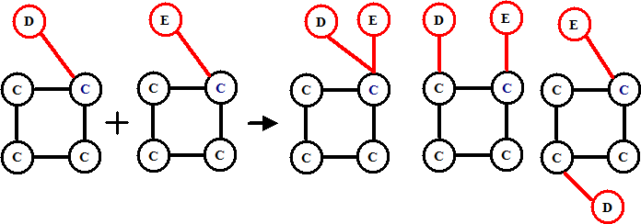
Candidate Generation: Vertex Growing vs. Edge Growing
Methodology: breadth-search, Apriori joining two size-k graphs
Many possibilities at generating size-(k+1) candidate graphs
Generating new graphs with one more vertex
AGM (Inokuchi, et al., PKDD’00)
Generating new graphs with one more edge
FSG (Kuramochi and Karypis, ICDM’01)
Performance shows via edge growing is more efficient

Slide 58
Pattern-Growth Approach
Depth-first growth of subgraphs from k-edge to (k+1)-edge, then (k+2)-edge subgraphs
(k+2)-edge
Major challenge
Generating many duplicate subgraphs
Major idea to solve the problem
Define an order to generate subgraphs
DFS spanning tree: Flatten a graph into a sequence using depth-first search
gSpan (Yan & Han: ICDM’02)
(k+1)-edge
G₁
…
k-edge
G₂
duplicate
graphs
G
…
G_{n}
…
Notes:
Apriori:
Step1: Join two k-1 edge graphs (these two graphs share a same k-2 edge subgraph) to generate a k-edge graph
Step2: Join the tid-list of these two k-1 edge graphs, then see whether its count is larger than the minimum support
Step3: Check all k-1 subgraph of this k-edge graph to see whether all of them are frequent
Step4: After G successfully pass Step1-3, do support computation of G in the graph dataset, See whether it is really frequent.
gSpan:
Step1: Right-most extend a k-1 edge graph to several k edge graphs.
Step2: Enumerate the occurrence of this k-1 edge graph in the graph dataset, meanwhile, counting these k edge graphs.
Step3: Output those k edge graphs whose support is larger than the minimum support.
Pros:
1: gSpan avoid the costly candidate generation and testing some infrequent subgraphs.
2: No complicated graph operations, like joining two graphs and calculating its k-1 subgraphs.
3. gSpan is very simple
The key is how to do right most extension efficiently in graph. We invented DFS code for graph.

Slide 59
gSPAN: Graph Pattern Growth in Order
Right-most path extension in subgraph pattern growth
Right-most path: The path from root to the right-most leaf (choose the vertex w. the smallest index at each step)
Reduce generation of duplicate subgraphs
Completeness: The Enumeration of graphs using right-most path extension is complete
DFS Code: Flatten a graph into a sequence using depth-first search
e₀: (0,1)
0
e₁: (1,2)
1
e₂: (2,0)
e₃: (2,3)
2
e₄: (3,0)
4
e₅: (2,4)
3

Slide 60
Why Mining Closed Graph Patterns?
Challenge: An n-edge frequent graph may have 2^{n} subgraphs
Motivation: Explore closed frequent subgraphs to handle graph pattern explosion problem
A frequent graph G is closed if there exists no supergraph of G that carries the same support as G
Lossless compression: Does not contain non-closed graphs, but still ensures that the mining result is complete
Algorithm CloseGraph: Mines closed graph patterns directly
If this subgraph is closed in the graph dataset, it implies that none of its frequent super-graphs carries the same support

Slide 61
CLOSEGRAPH: Directly Mining Closed Graph Patterns
CloseGraph: Mining closed graph patterns by extending gSpan (Yan & Han, KDD’03)
At what condition can we
stop searching their children,
i.e., early termination?
G₁
k-edge
G₂
Suppose G and G₁ are frequent, and G is a subgraph of G₁
If in any part of the graph in the dataset where G occurs, G₁ also occurs, then we need not grow G (except some special, subtle cases), since none of G’s children will be closed except those of G₁
G
…
G_{n}
(k+1)-edge
Notes:
Apriori:
Step1: Join two k-1 edge graphs (these two graphs share a same k-2 edge subgraph) to generate a k-edge graph
Step2: Join the tid-list of these two k-1 edge graphs, then see whether its count is larger than the minimum support
Step3: Check all k-1 subgraph of this k-edge graph to see whether all of them are frequent
Step4: After G successfully pass Step1-3, do support computation of G in the graph dataset, See whether it is really frequent.
gSpan:
Step1: Right-most extend a k-1 edge graph to several k edge graphs.
Step2: Enumerate the occurrence of this k-1 edge graph in the graph dataset, meanwhile, counting these k edge graphs.
Step3: Output those k edge graphs whose support is larger than the minimum support.
Pros:
1: gSpan avoid the costly candidate generation and testing some infrequent subgraphs.
2: No complicated graph operations, like joining two graphs and calculating its k-1 subgraphs.
3. gSpan is very simple
The key is how to do right most extension efficiently in graph. We invented DFS code for graph.

Slide 62
Experiment and Performance Comparison
The AIDS antiviral screen compound dataset from NCI/NIH
The dataset contains 43,905 chemical compounds
Discovered Patterns: The smaller minimum support, the bigger and more interesting subgraph patterns discovered
20%
10%
5%
# of Patterns: Frequent vs. Closed
Runtime: Frequent vs. Closed
Run time (sec)
Number of patterns
Minimum support
Minimum support

Slide 63
Chapter 7 : Advanced Frequent Pattern Mining
Pattern Mining: A Road Map
Mining Diverse Patterns
Constraint-Based Frequent Pattern Mining
Mining High-Dimensional Data and Colossal Patterns
Sequential Pattern Mining
Graph Pattern Mining
Summary

Slide 64
References (I) Mining Diverse Patterns
R. Srikant and R. Agrawal, “Mining generalized association rules”, VLDB'95
Y. Aumann and Y. Lindell, “A Statistical Theory for Quantitative Association Rules”, KDD'99
K. Wang, Y. He, J. Han, “Pushing Support Constraints Into Association Rules Mining”, IEEE Trans. Knowledge and Data Eng. 15(3): 642-658, 2003
D. Xin, J. Han, X. Yan and H. Cheng, "On Compressing Frequent Patterns", Knowledge and Data Engineering, 60(1): 5-29, 2007
D. Xin, H. Cheng, X. Yan, and J. Han, "Extracting Redundancy-Aware Top-K Patterns", KDD'06
J. Han, H. Cheng, D. Xin, and X. Yan, "Frequent Pattern Mining: Current Status and Future Directions", Data Mining and Knowledge Discovery, 15(1): 55-86, 2007
F. Zhu, X. Yan, J. Han, P. S. Yu, and H. Cheng, “Mining Colossal Frequent Patterns by Core Pattern Fusion”, ICDE'07

Slide 65
References (II) Constraint-Based Frequent Pattern Mining
R. Srikant, Q. Vu, and R. Agrawal, “Mining association rules with item constraints”, KDD'97
R. Ng, L.V.S. Lakshmanan, J. Han & A. Pang, “Exploratory mining and pruning optimizations of constrained association rules”, SIGMOD’98
G. Grahne, L. Lakshmanan, and X. Wang, “Efficient mining of constrained correlated sets”, ICDE'00
J. Pei, J. Han, and L. V. S. Lakshmanan, “Mining Frequent Itemsets with Convertible Constraints”, ICDE'01
J. Pei, J. Han, and W. Wang, “Mining Sequential Patterns with Constraints in Large Databases”, CIKM'02
F. Bonchi, F. Giannotti, A. Mazzanti, and D. Pedreschi, “ExAnte: Anticipated Data Reduction in Constrained Pattern Mining”, PKDD'03
F. Zhu, X. Yan, J. Han, and P. S. Yu, “gPrune: A Constraint Pushing Framework for Graph Pattern Mining”, PAKDD'07

Slide 66
References (III) Sequential Pattern Mining
R. Srikant and R. Agrawal, “Mining sequential patterns: Generalizations and performance improvements”, EDBT’96
M. Zaki, “SPADE: An Efficient Algorithm for Mining Frequent Sequences”, Machine Learning, 2001
J. Pei, J. Han, B. Mortazavi-Asl, J. Wang, H. Pinto, Q. Chen, U. Dayal, and M.-C. Hsu, "Mining Sequential Patterns by Pattern-Growth: The PrefixSpan Approach", IEEE TKDE, 16(10), 2004
X. Yan, J. Han, and R. Afshar, “CloSpan: Mining Closed Sequential Patterns in Large Datasets”, SDM'03
J. Pei, J. Han, and W. Wang, "Constraint-based sequential pattern mining: the pattern-growth methods", J. Int. Inf. Sys., 28(2), 2007
M. N. Garofalakis, R. Rastogi, K. Shim: Mining Sequential Patterns with Regular Expression Constraints. IEEE Trans. Knowl. Data Eng. 14(3), 2002
H. Mannila, H. Toivonen, and A. I. Verkamo, “Discovery of frequent episodes in event sequences”, Data Mining and Knowledge Discovery, 1997

Slide 67
References (III) Graph Pattern Mining
C. Borgelt and M. R. Berthold, Mining molecular fragments: Finding relevant substructures of molecules, ICDM'02
J. Huan, W. Wang, and J. Prins. Efficient mining of frequent subgraph in the presence of isomorphism, ICDM'03
A. Inokuchi, T. Washio, and H. Motoda. An apriori-based algorithm for mining frequent substructures from graph data, PKDD'00
M. Kuramochi and G. Karypis. Frequent subgraph discovery, ICDM'01
S. Nijssen and J. Kok. A Quickstart in Frequent Structure Mining can Make a Difference. KDD'04
N. Vanetik, E. Gudes, and S. E. Shimony. Computing frequent graph patterns from semistructured data, ICDM'02
X. Yan and J. Han, gSpan: Graph-Based Substructure Pattern Mining, ICDM'02
X. Yan and J. Han, CloseGraph: Mining Closed Frequent Graph Patterns, KDD'03
X. Yan, P. S. Yu, J. Han, Graph Indexing: A Frequent Structure-based Approach, SIGMOD'04
X. Yan, P. S. Yu, and J. Han, Substructure Similarity Search in Graph Databases, SIGMOD'05

Slide 68

Notes:
Little Mermaid, Hans Christian Andersen

Slide 69

Appendix: Correction in Original Textbook and Helping Slides for Mining Colossal Patterns

Slide 70
Note: Correction in the Original Textbook
Example 7.11 Core patterns. Line 4 should be
Therefore, |D_{α1}|/|D_{(ab)}| = 200/200 ≥ τ
Figure 7.9. A transaction database, which contains duplicates, and core patterns for each distinct transactions (The corrected table contents should be as follows)
Transaction (# of transactions) | Core Patterns (τ = 0.5)
(abe) (100) | (abe), (ab), (be), (ae), (a), (b), (e)
(bcf) (100) | (bcf), (bc), (bf), (cf), (b), (c), (f)
(acf) (100) | (acf), (ac), (af), (a), (c), (f)
(abcef) (100) | (ab), (ac), (ae), (af), (bc), (be), (bf), (ce), (ef), (e), (abc), (abf), (abe) (ace), (acf), (aef), (bcf), (bce), (bef) (cef), (abcf), (abce), (abef), (acef), (bcef), (abcef)

Slide 71
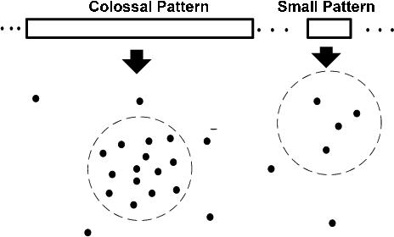
Colossal Patterns Correspond to Dense Balls
Pattern distance: For patterns α and β, the pattern distance of α and β is defined to be:
If two patterns α and β are both core patterns of the same pattern, they would be bounded by a “ball” of a radius specified by their core ratio τ
Due to their robustness, colossal patterns correspond to dense balls
Ω( 2^d) in population
A random draw in the pattern space will hit somewhere in the ball with high probability

Slide 72
Observation: Colossal Patterns and Core Patterns
A colossal pattern has far more core patterns than a small-sized pattern
A colossal pattern has far more core descendants of a smaller size c
A random draw from a complete set of pattern of size c would be more likely to pick a core descendant of a colossal pattern
A colossal pattern can be generated by merging a set of core patterns
A colossal pattern α
α
α1
α2
αk
Subpatterns α₁ to α_{k} cluster tightly around the colossal pattern α by sharing a similar support. Such subpatterns are core patterns of α

Slide 73
SpiderMine: Mining Top-K Large Structural Patterns in a Massive Network
Large patterns are informative to characterize a large network (e.g., social network, web, or bio-network)
Similar to pattern fusion, mining large pattern should not aim for completeness but for representativeness of the target results
Spider-Mine (F. Zhu, et al., VLDB'11): Mine top-K largest frequent substructure patterns whose diameter is bounded by D_{max} with a probability at least 1−ϵ
General idea: Large patterns are composed of a number of small components (“spiders”) which will eventually connect together after some rounds of pattern growth
r-Spider: An r-spider is a frequent graph pattern P such that there exists a vertex u of P, and all other vertices of P are within distance r from u
r
u

Slide 74
Why Is SpiderMine Good for Mining Large Patterns
The SpiderMine Algorithm
Mine the set S of all the r-spiders
Randomly draw M r-spiders
Grow these M r-spiders for t = D_{max}/2 iterations, and merge two patterns whenever possible
Discard unmerged patterns
Continue to grow the remaining ones to maximum size
Return the top-K largest ones in the result
Why is SpiderMine likely to retain large patterns and prune small ones?
Small patterns are much less likely to be hit in the random draw
Even if a small pattern is hit, it is even less likely to be hit multiple times
The larger the pattern, the greater the chance it is hit and saved

Slide 75
Mining Collaboration Patterns in DBLP Networks
Data description: 600 top confs, 9 major CS areas, 15071 authors in DB/DM
Author labeled by # of papers published in DB/DM
Prolific (P): >=50, Senior (S): 20~49, Junior (J): 10~19, Beginner(B): 5~9
Patterns found
Instance in data
Instance in data
Patterns found
Instance in data
Instance in data
Patterns found

Slide 76
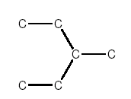
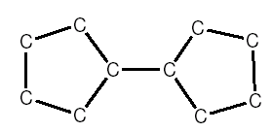
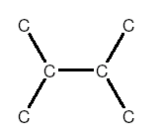
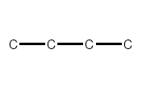
Application of Pattern Mining I: Graph Indexing
Graph query: Find all the graphs in a graph DB containing a given query graph
Index should be a powerful tool
Path-index may not work well
Solution: Index directly on substructures (i.e., graphs)
Query graph (Q)
Graph (G)
Substructure
Query Q:
Graph DB:
(a)
(b)
(c)
Only graph (c) contains Q
Path-indices: C, C-C, C-C-C, C-C-C-C cannot prune (a) & (b)

Slide 77
gIndex: Indexing Frequent and Discriminative Substructures
Why index frequent substructures?
Too many substructures to index
Size-increasing support threshold
Large structures will likely be indexed well by their substructures
Why discriminative substructures?
support
min-support threshold
size
Reduce the index size by an order of magnitude
Selection: Given a set of selected structures f₁, f₂, .. f_{n}, and a new structure x, the extra indexing power is measured by
when Pr(x|f₁, f₂, …, f_{n}) is small enough, x is a discriminative structure and should be included in the index
Experiments show gIndex is small, effective and stable

Slide 78
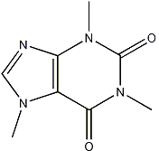
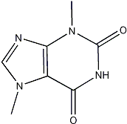
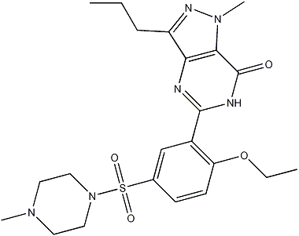
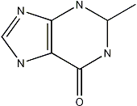
Application II: Support Substructure Similarity Search
Find graphs in a graph DB containing substructures similar to a given query graph
Ex. Data: A chemical compound DB
A query graph:
(a)
(b)
How to do similarity search efficiently?
No indexing?—Sequential scan + computing subgraph similarity—too costly!
(c)
Build graph indices to support approximate search?
Need an explosive number of subgraphs to cover all the similar subgraphs!
An elegant solution (Yan et al., SIGMOD’05):
Keep the graph index structure, but select features in the query space

Slide 79
Feature-Based Similarity Search
Decompose a query graph into a set of features
Query (Q)
Feature-based similarity measure
Each graph is represented as a feature vector X = {x₁, x₂, …, x_{n}}
Similarity is defined by the distance of their corresponding vectors
Graph (G₁)
Substructure
Graph (G₂)
If graph G contains the major part of a query graph Q, G should share a number of common features with Q
Given a relaxation ratio, one can calculate the maximal number of features that can be missed !
Graphs in database
 | G₁ | G₂ | G₃ | G₄ | G₅
f₁ | 0 | 1 | 0 | 1 | 1
f₂ | 0 | 1 | 0 | 0 | 1
f₃ | 1 | 0 | 1 | 1 | 1
f₄ | 1 | 0 | 0 | 0 | 1
f₅ | 0 | 0 | 1 | 1 | 0
features
Assume: Query graph has 5 features
Relaxation threshold: can miss at most 2 features
Then: G₁, G₂, G₃ are pruned
A feature-graph matrix

